Slide 1
CS06440 Assignment 03 AWS
Name: Chad Andreniuk
School ID: andren54

Slide 2
Tutorials you’ve selected for Q 01
(One video per category)
# | AWS Category | Implemented
1 | Account Management | Increase account service quotas with Service Quotas
2 | Analytics | Visualize data in Amazon RDS for SQL Server using Amazon QuickSight
3 | Compute | Create object storage buckets
4 | Databases | Store and Retrieve a File
5 | Dev Tools | Remotely Run Commands on an EC2 instance
6 | End User Compute | Amazon WorkSpeace Cost Optimizer
7 | Machine Learning | Introduction to Deep Learning
8 | Storage | Store and Retrieve a File (S3)
9 | Serverless | Run a Serverless “Hello, World!”
10 | Serverless | AWS Applicaion Services Overvew

Slide 3
Screenshots for ten tuutorials you’ve selected for Q 01
Provide one clear screenshot for each tutorial you’ve watched/practiced.

Slide 4
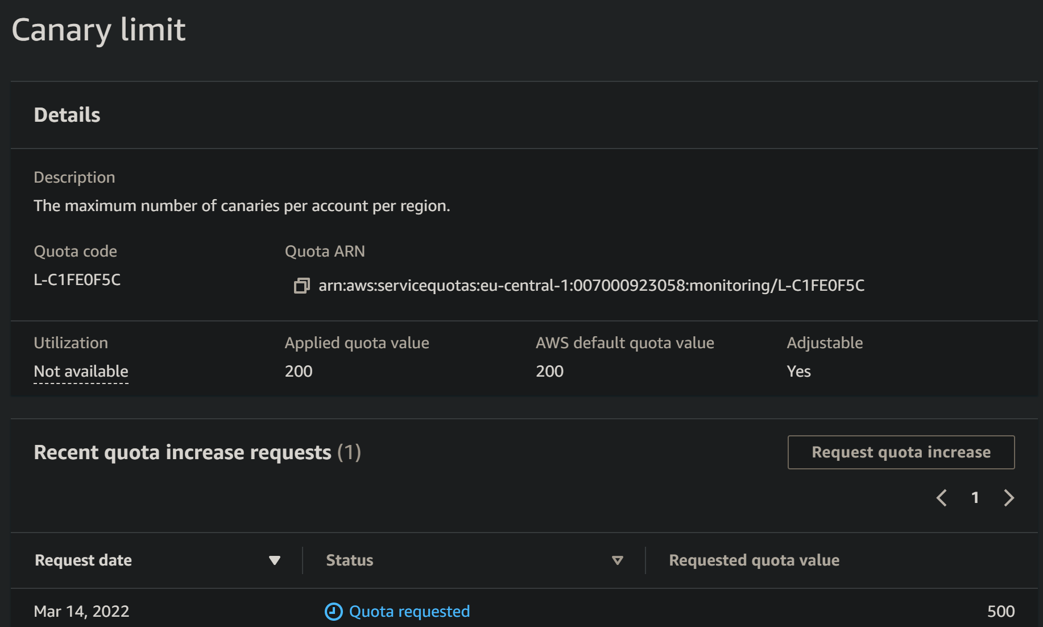
One Screenshot for Tutorial # 01 from Category “xyz”

Slide 5
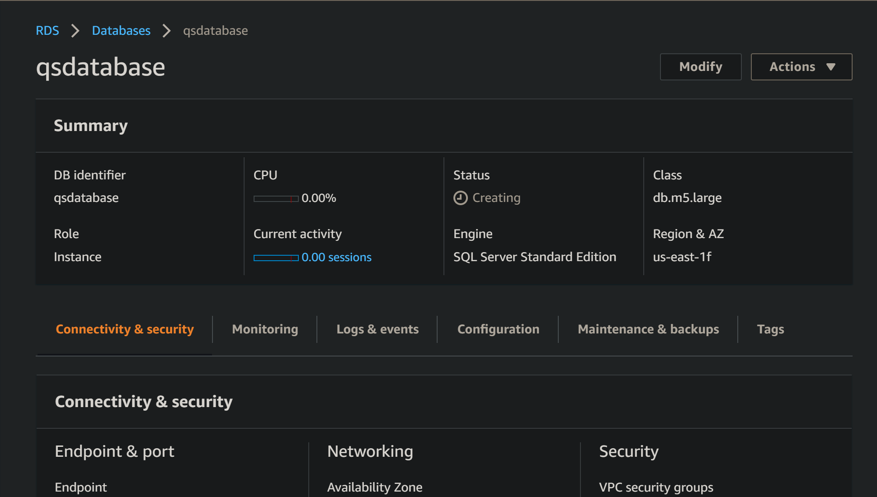
One Screenshot for Tutorial # 02 from Category “xyz”

Slide 6
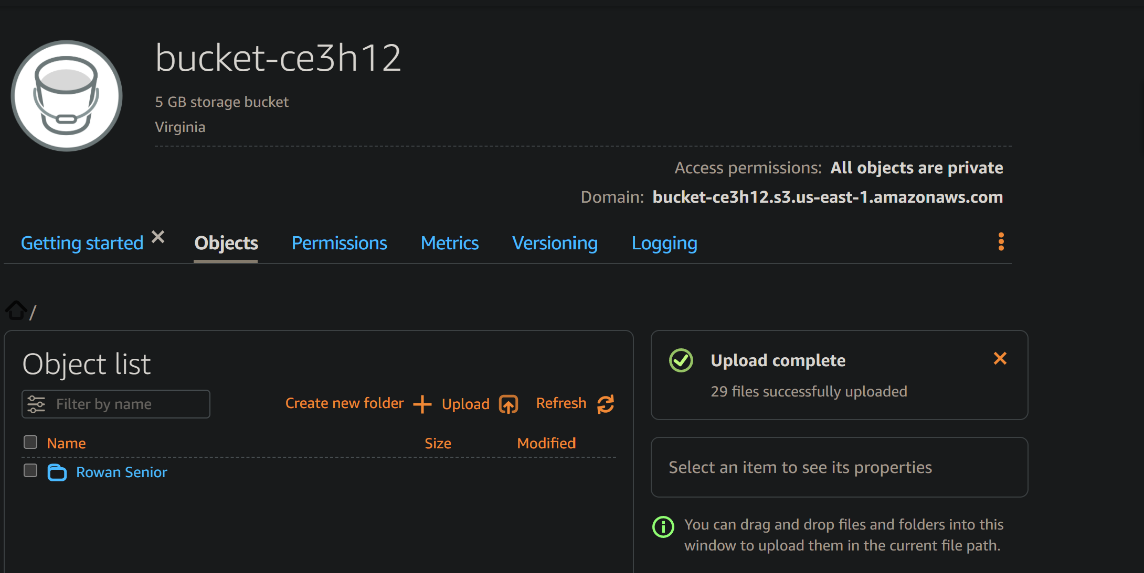
One Screenshot for Tutorial # 03 from Category “xyz”

Slide 7
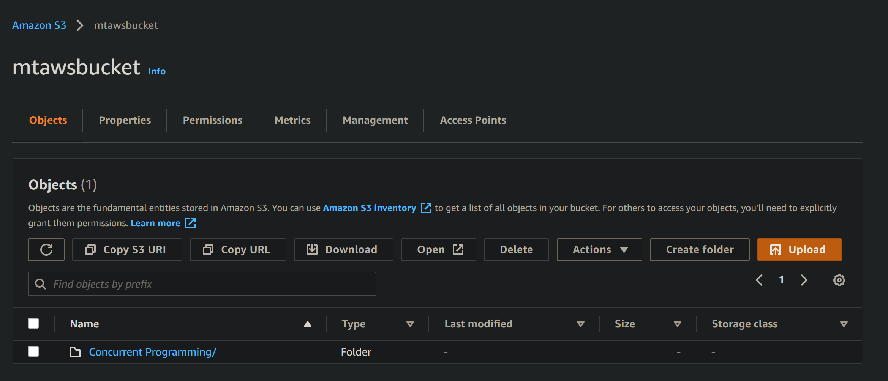
One Screenshot for Tutorial # 04 from Category “xyz”

Slide 8
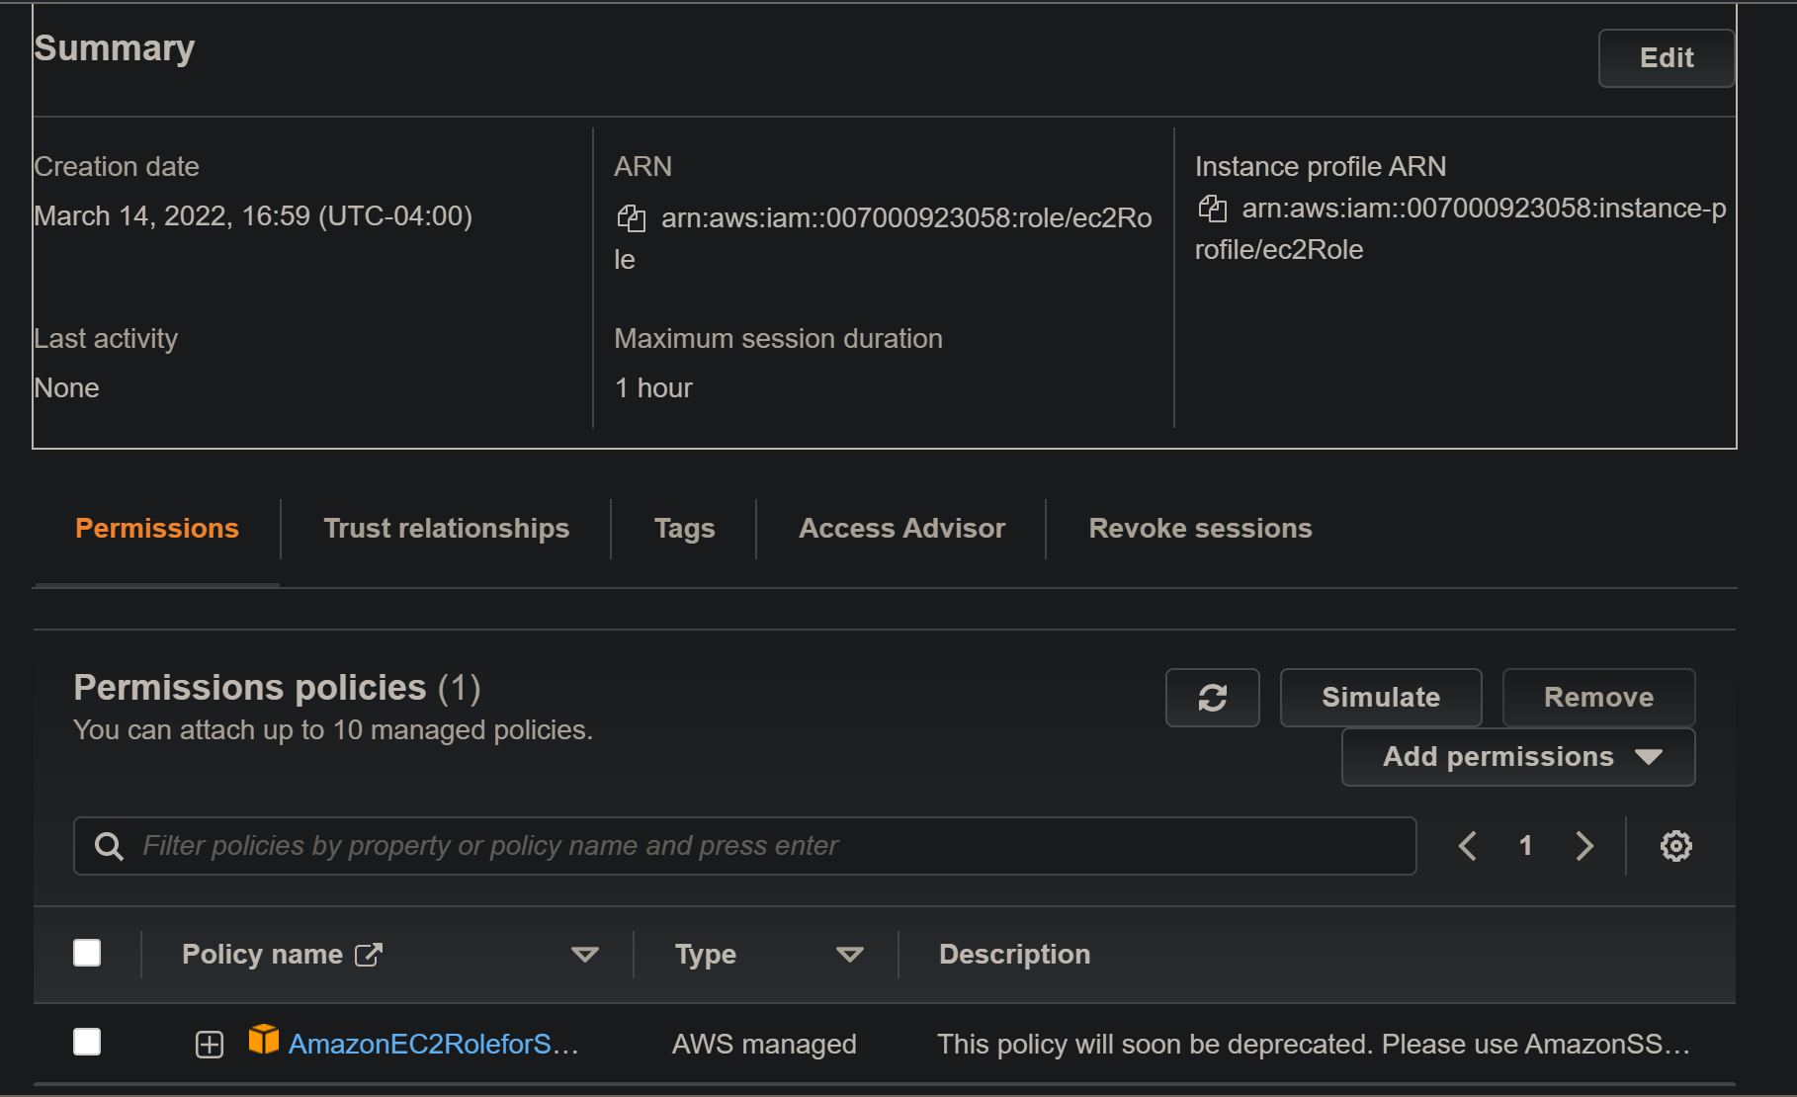
One Screenshot for Tutorial # 05 from Category “xyz”

Slide 9
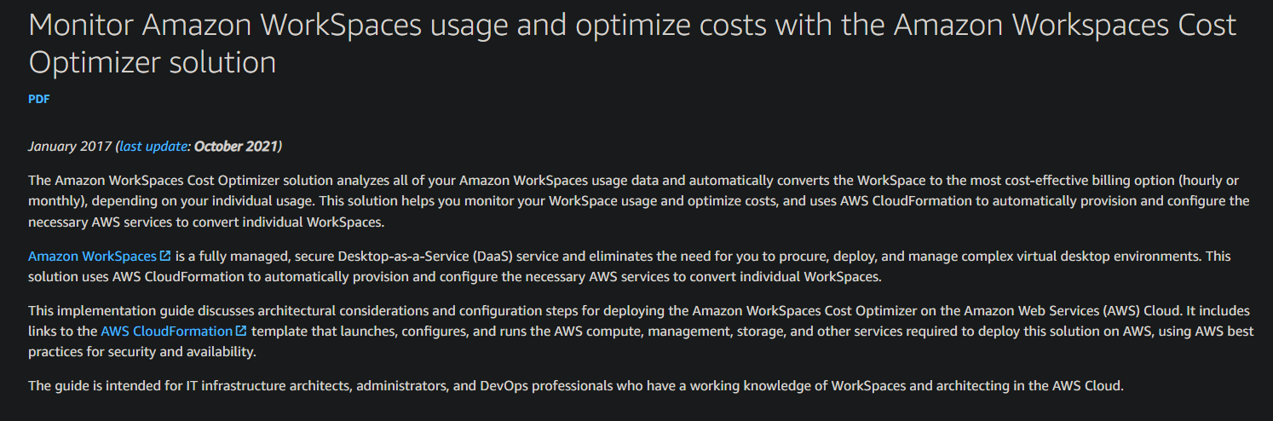
One Screenshot for Tutorial # 06 from Category “xyz”

Slide 10
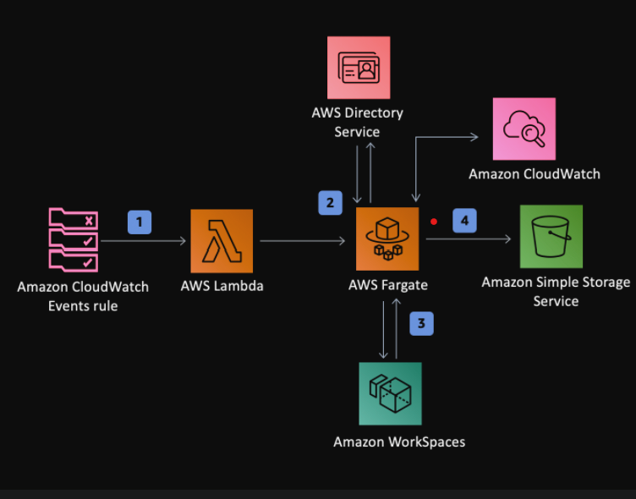
One Screenshot for Tutorial # 07 from Category “xyz”

Slide 11
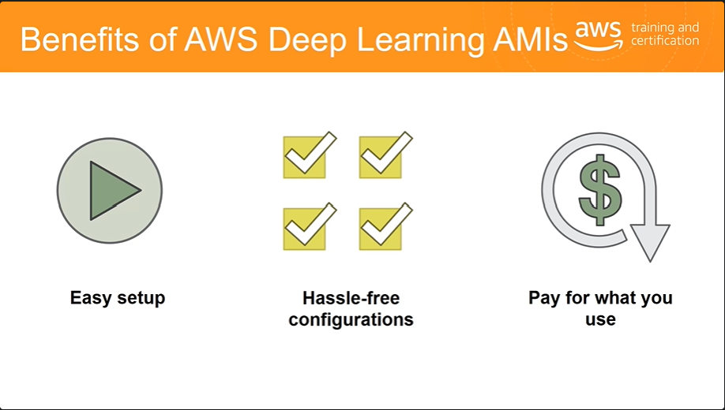
One Screenshot for Tutorial # 08 from Category “xyz”

Slide 12
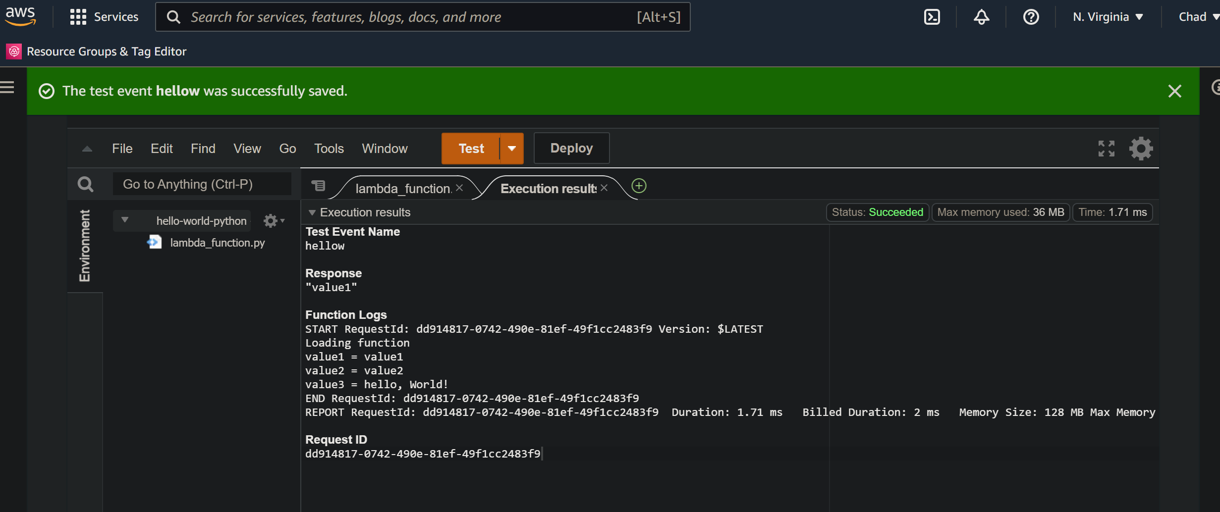
One Screenshot for Tutorial # 09 from Category “xyz”

Slide 13
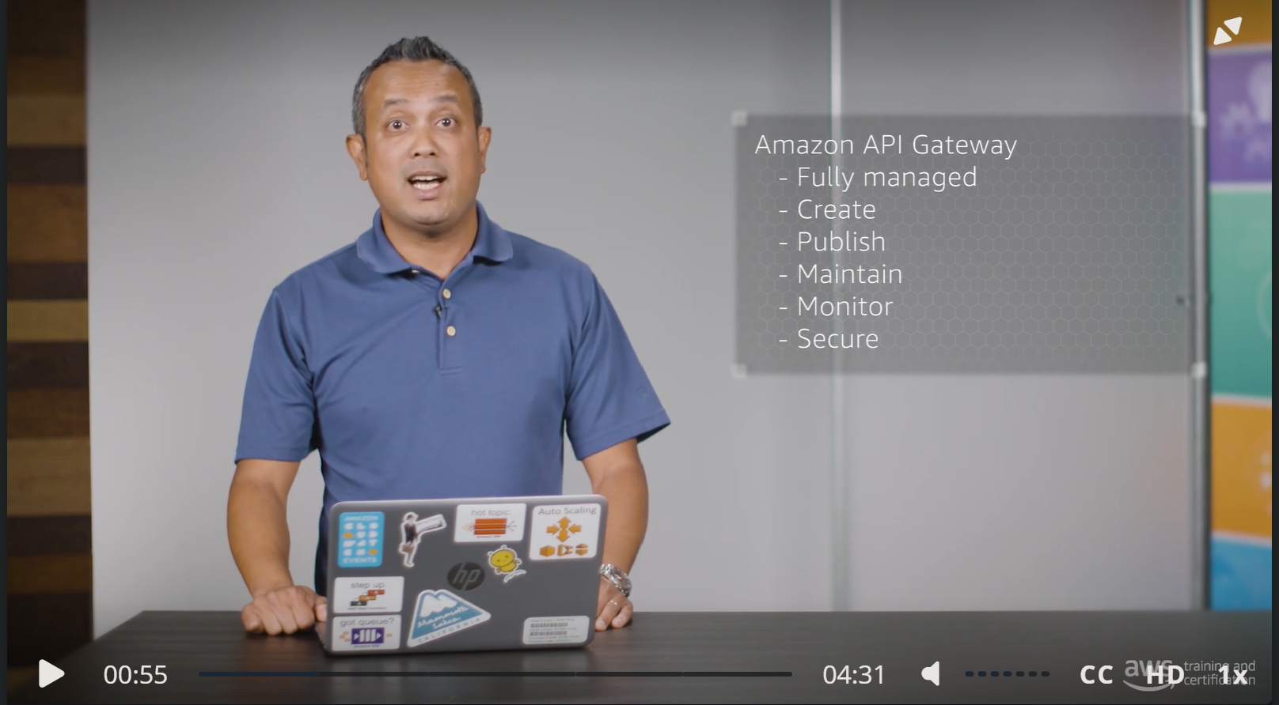
One Screenshot for Tutorial # 10 from Category “xyz”

Slide 14
Services you’ve used for Q 02
(at least 5 components, in this example, the student picked 10)
# | AWS Category | Implemented
1 | Cost Management | AWS Cost Explorer
2 | Databases | MySQL
3 | Enterprise Applications | Send Notifications Service (SNS)
4 | Enterprise Applications | Send an Email (SES)
5 | Machine Learning | Analyze Sentiment in Text (Amazon Comprehend)
6 | Websites & Apps | Route 53
7 | Websites & Apps | Launch a Linux Virtual Machine (EC2 / Lightsail)
8 | Storage | Store and Retrieve a File (S3)
9 | Security | Identity and Access Management
10 | Cost Management | AWS Budgets (Lightsail alerts too)

Slide 15
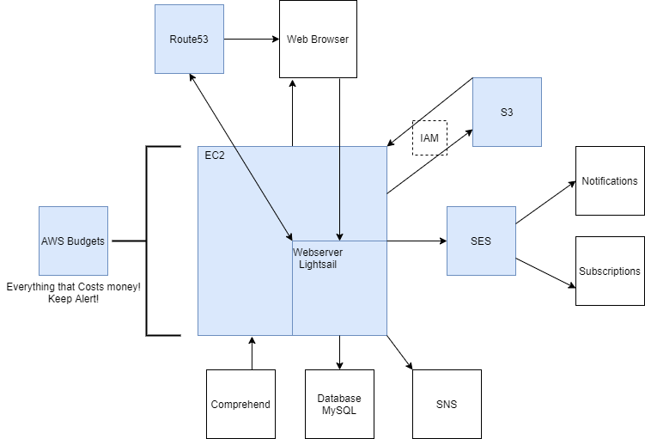
Your Completed Project Flowchart for Q 02
→ The arrows represent connections between service

Slide 16
Screenshots for your own Project Services
Now, provide screenshots for the components you have used to create your AWS project
“The following screenshots are for examples only”

Slide 17
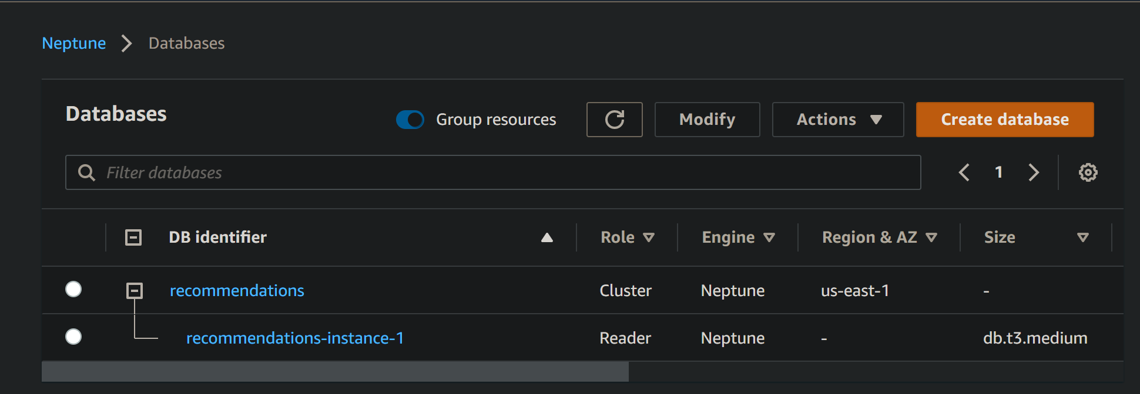
Amazon Neptue DB

Slide 18
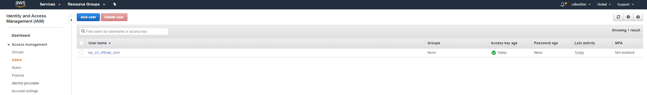
Identity and Access Management (IAM)

Slide 19
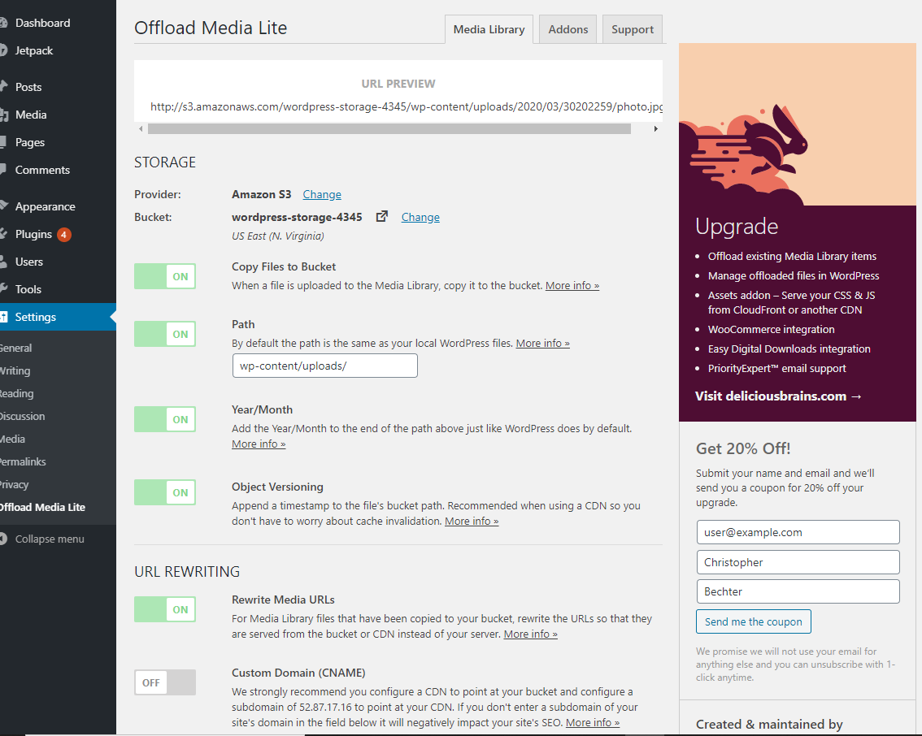
S3 Storage

Slide 20
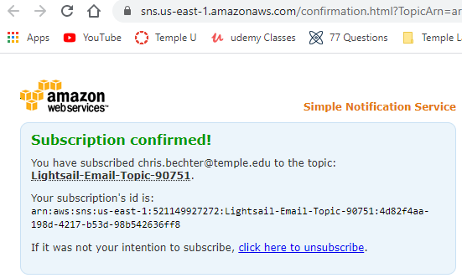
Simple Notification System

Slide 21
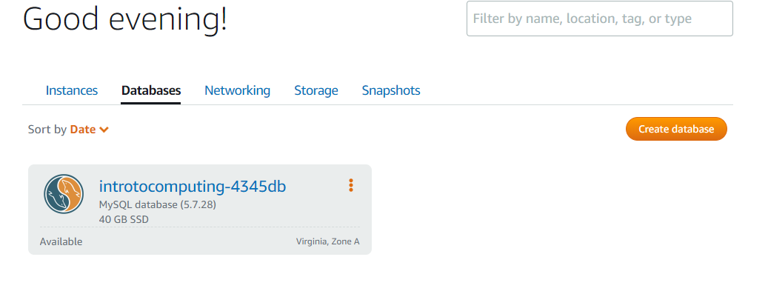
MySQL Database

Slide 22
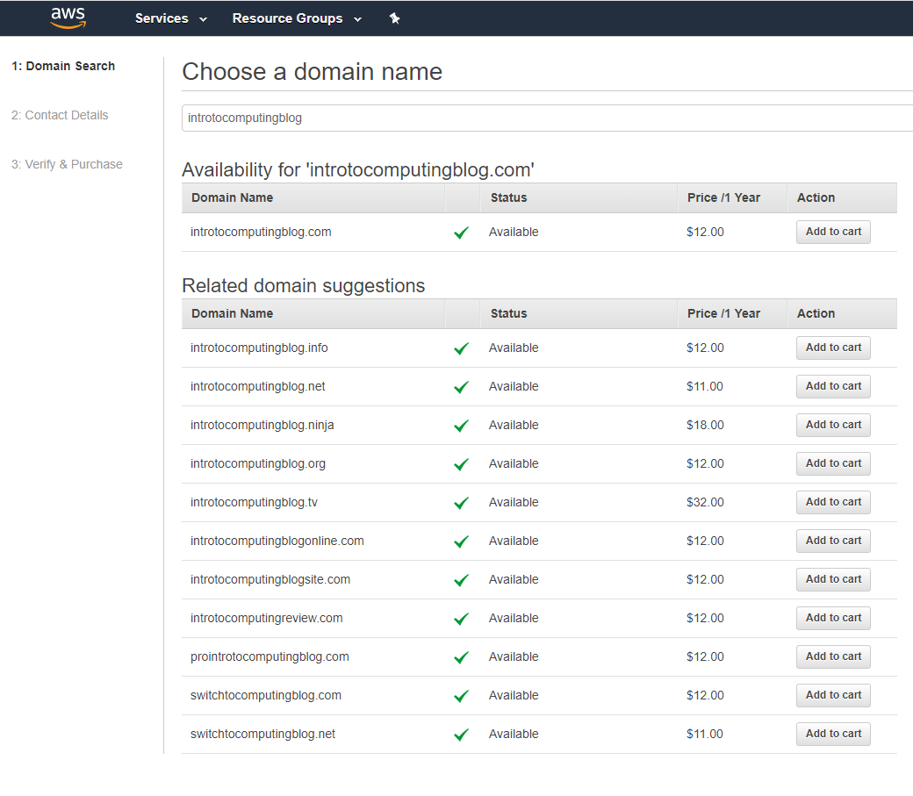
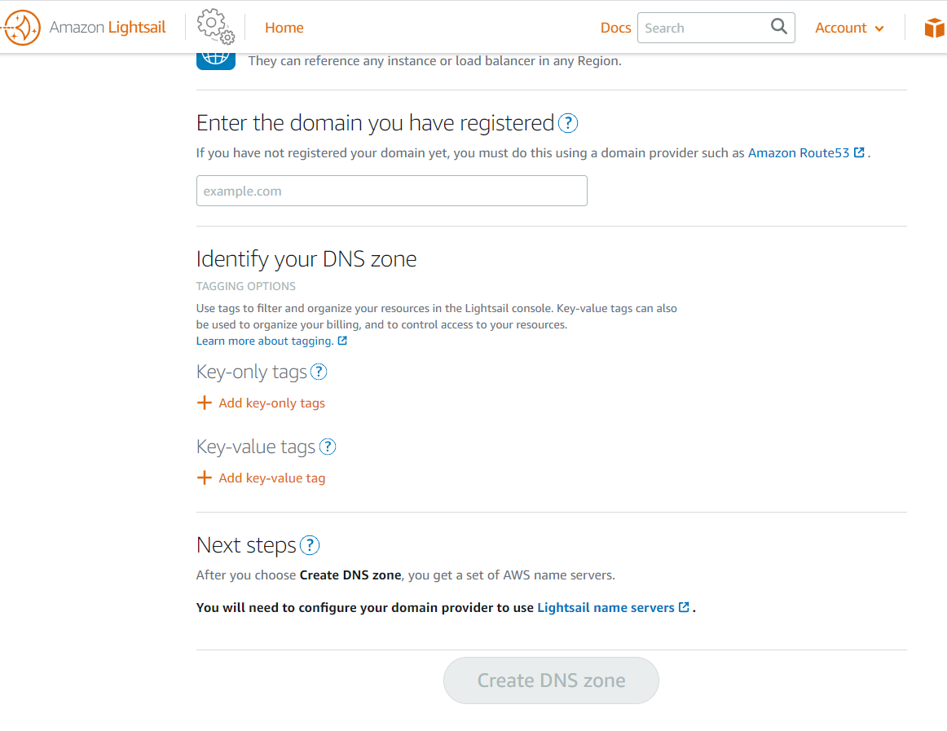
Route 53 (cost money)

Slide 23
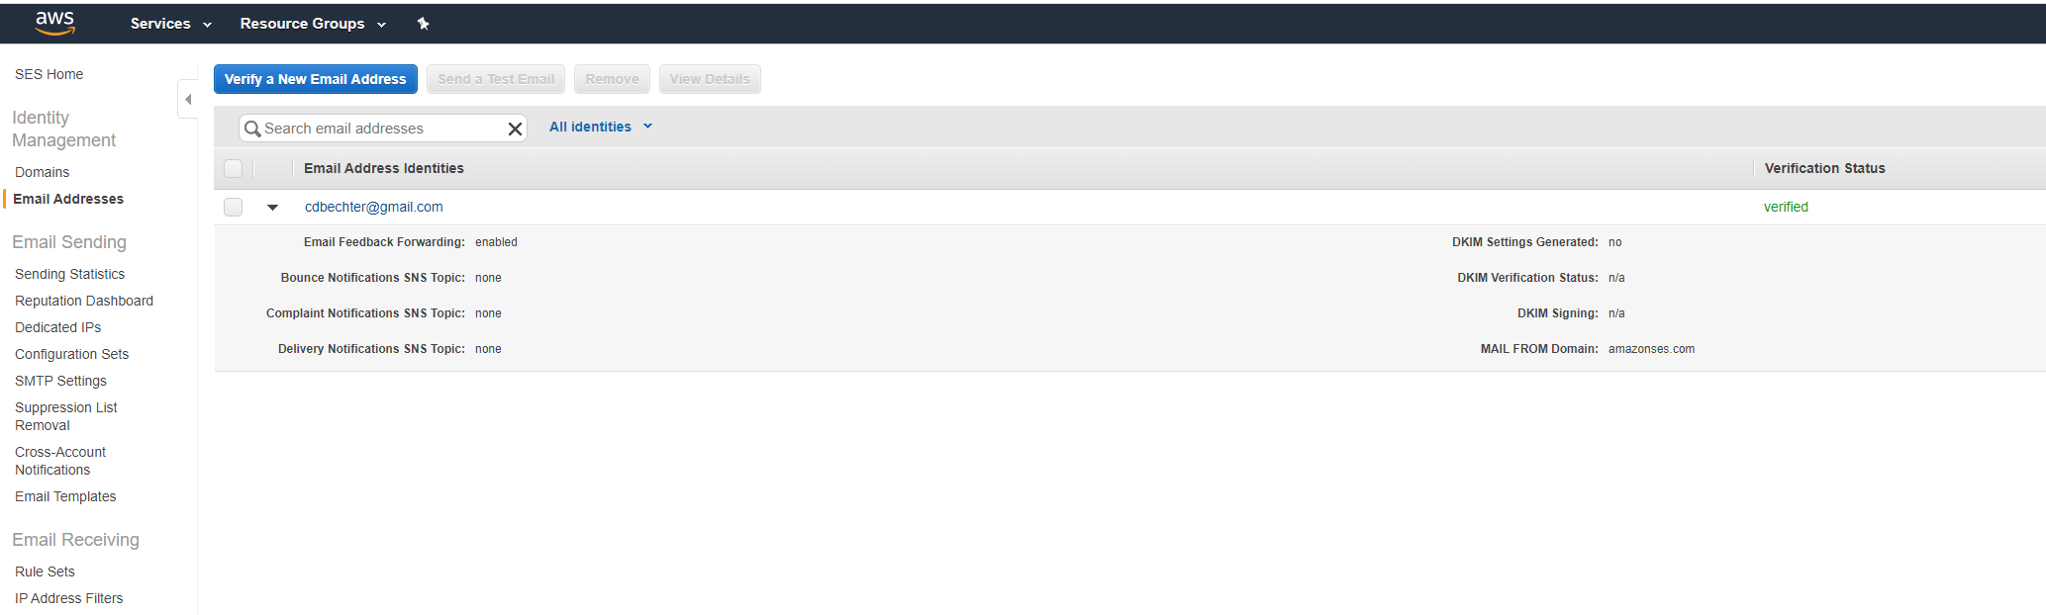
Simple Email Service (SES) (cost money)

Slide 24
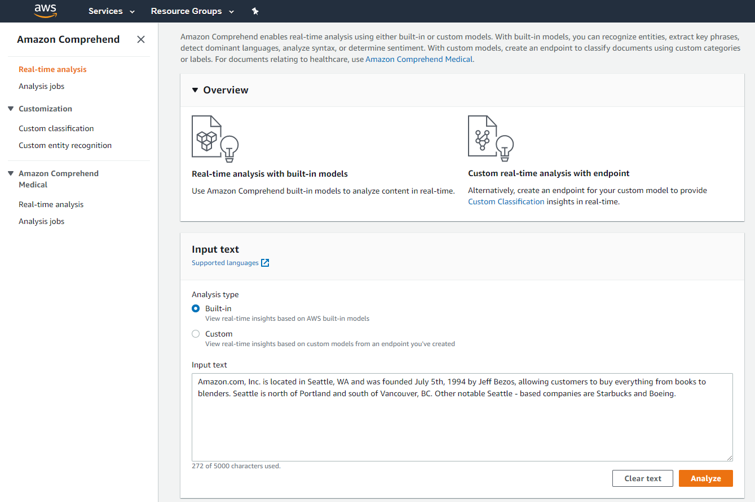
Machine Learning - Comprehend

Slide 25
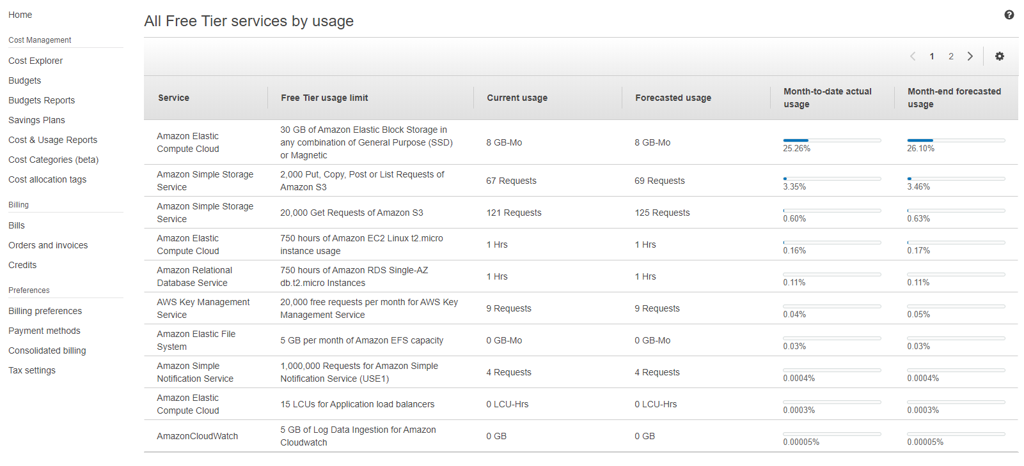
Cost & Billing

Slide 26
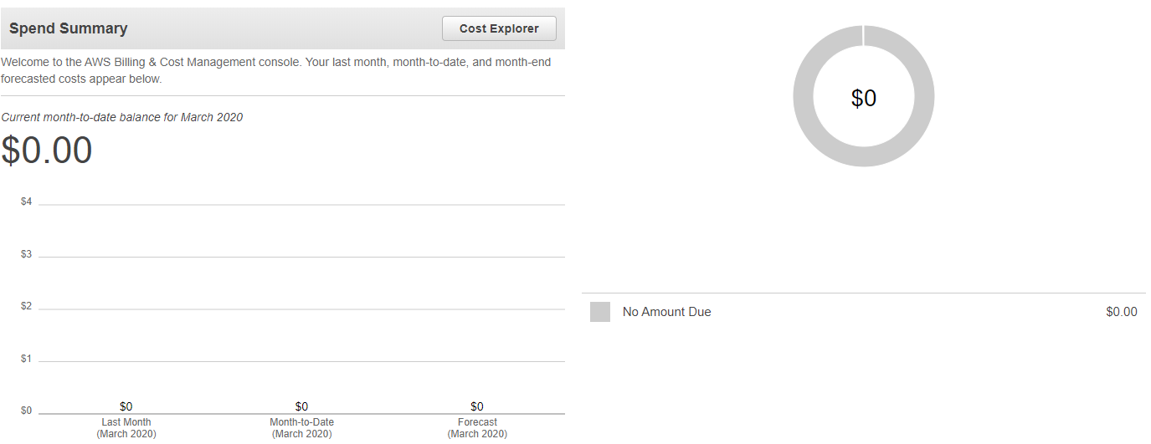
Cost & Billing

Slide 27
Conclusion
How many hours did it take you to finish the assignment?
This assignemt took me twice as long as it should have as I was almost done, then lost evrything because I went home for spring break leaving my files on my PC at school. Besides that the assignment took me 8 hours total to complete
What was your project cost at the end?
In the end my project cost 0$
Name two pros of AWS (let’s say two things you like) and why?
AWS allows people to easily do many different things
AWS is very versitle and has mamy different features
Name two cons of AWS (let’s say two things you don’t like) and why?

